Slide 1
Analysis of Forest Bioacoustics Exploring the Soundscapes of Northern Michigan
Jeremy Babila
Ian Rhynard

Slide 2
Outline
Introduction/Abstract
Methodology
Biodiversity through soundscapes
AudioMoth Recorders
Preprocessing
Converting Sound into Data
Visualizing Sound
Exploration
Comparing activity of different locations
Classification
Logistic Modeling
cNN of Spectrograms
cNN of Frequency Correlation Heat Maps
Results
Model Accuracy
Soundscape Timeline through Predictive Modeling

Slide 3
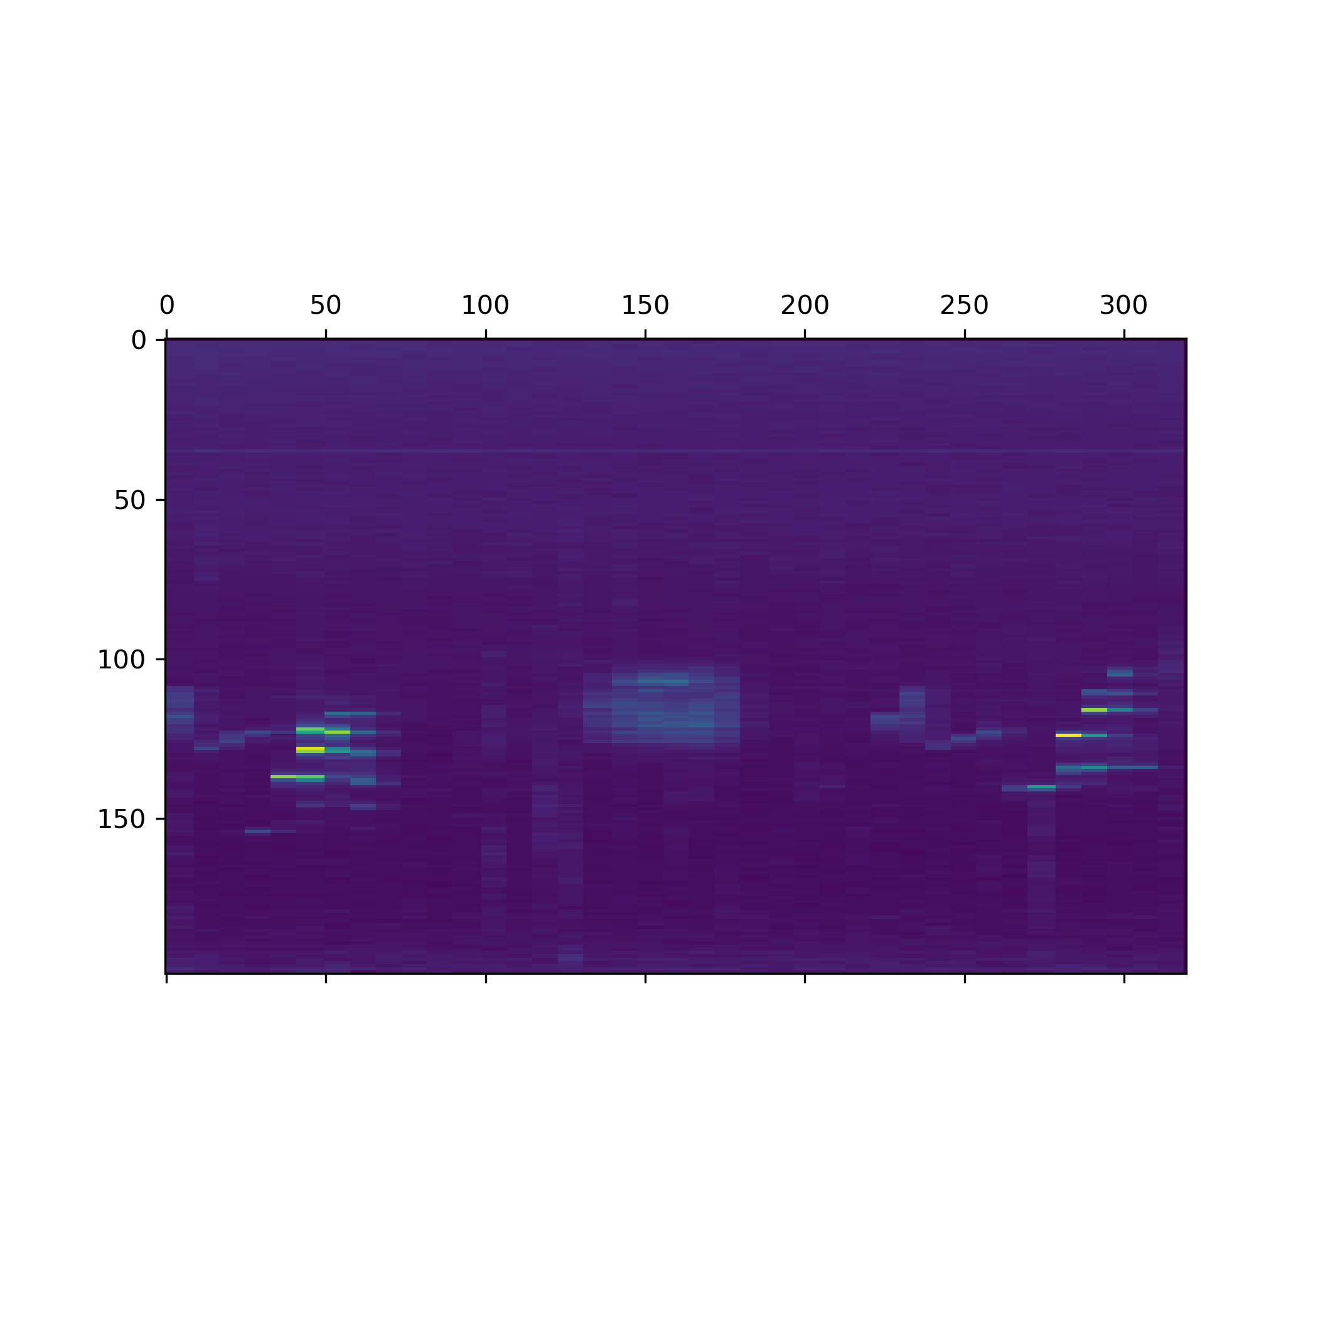
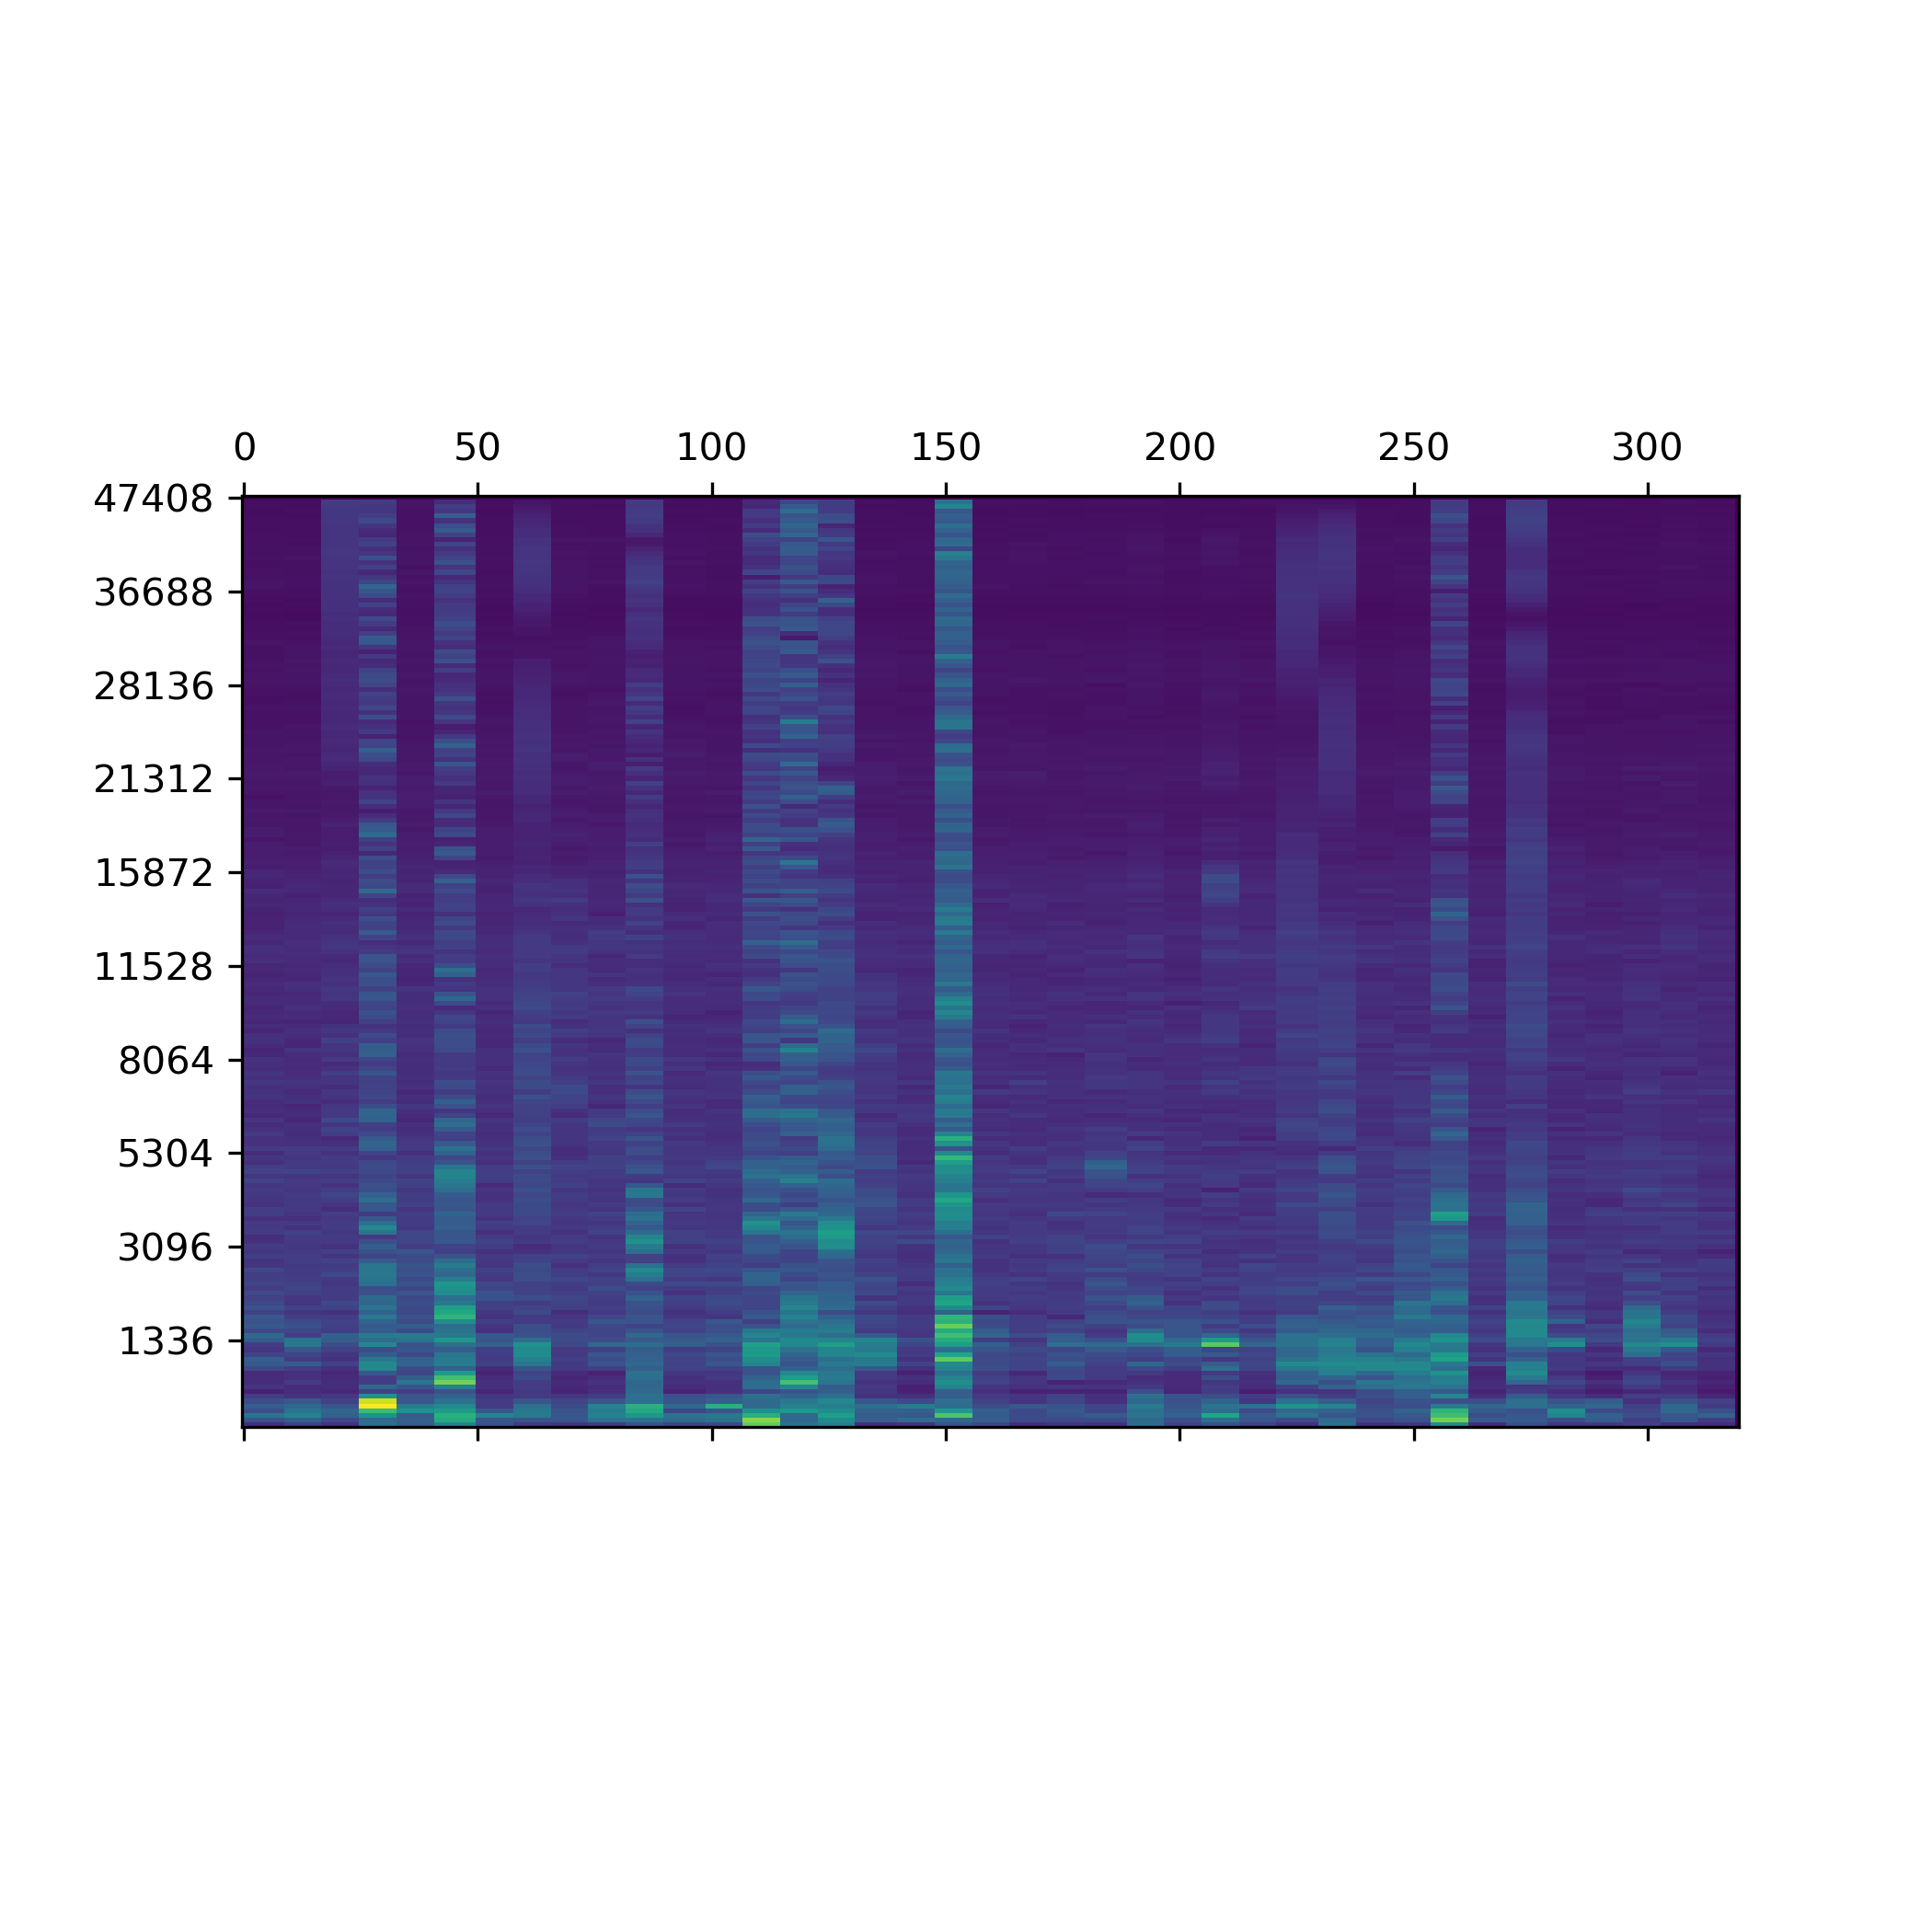
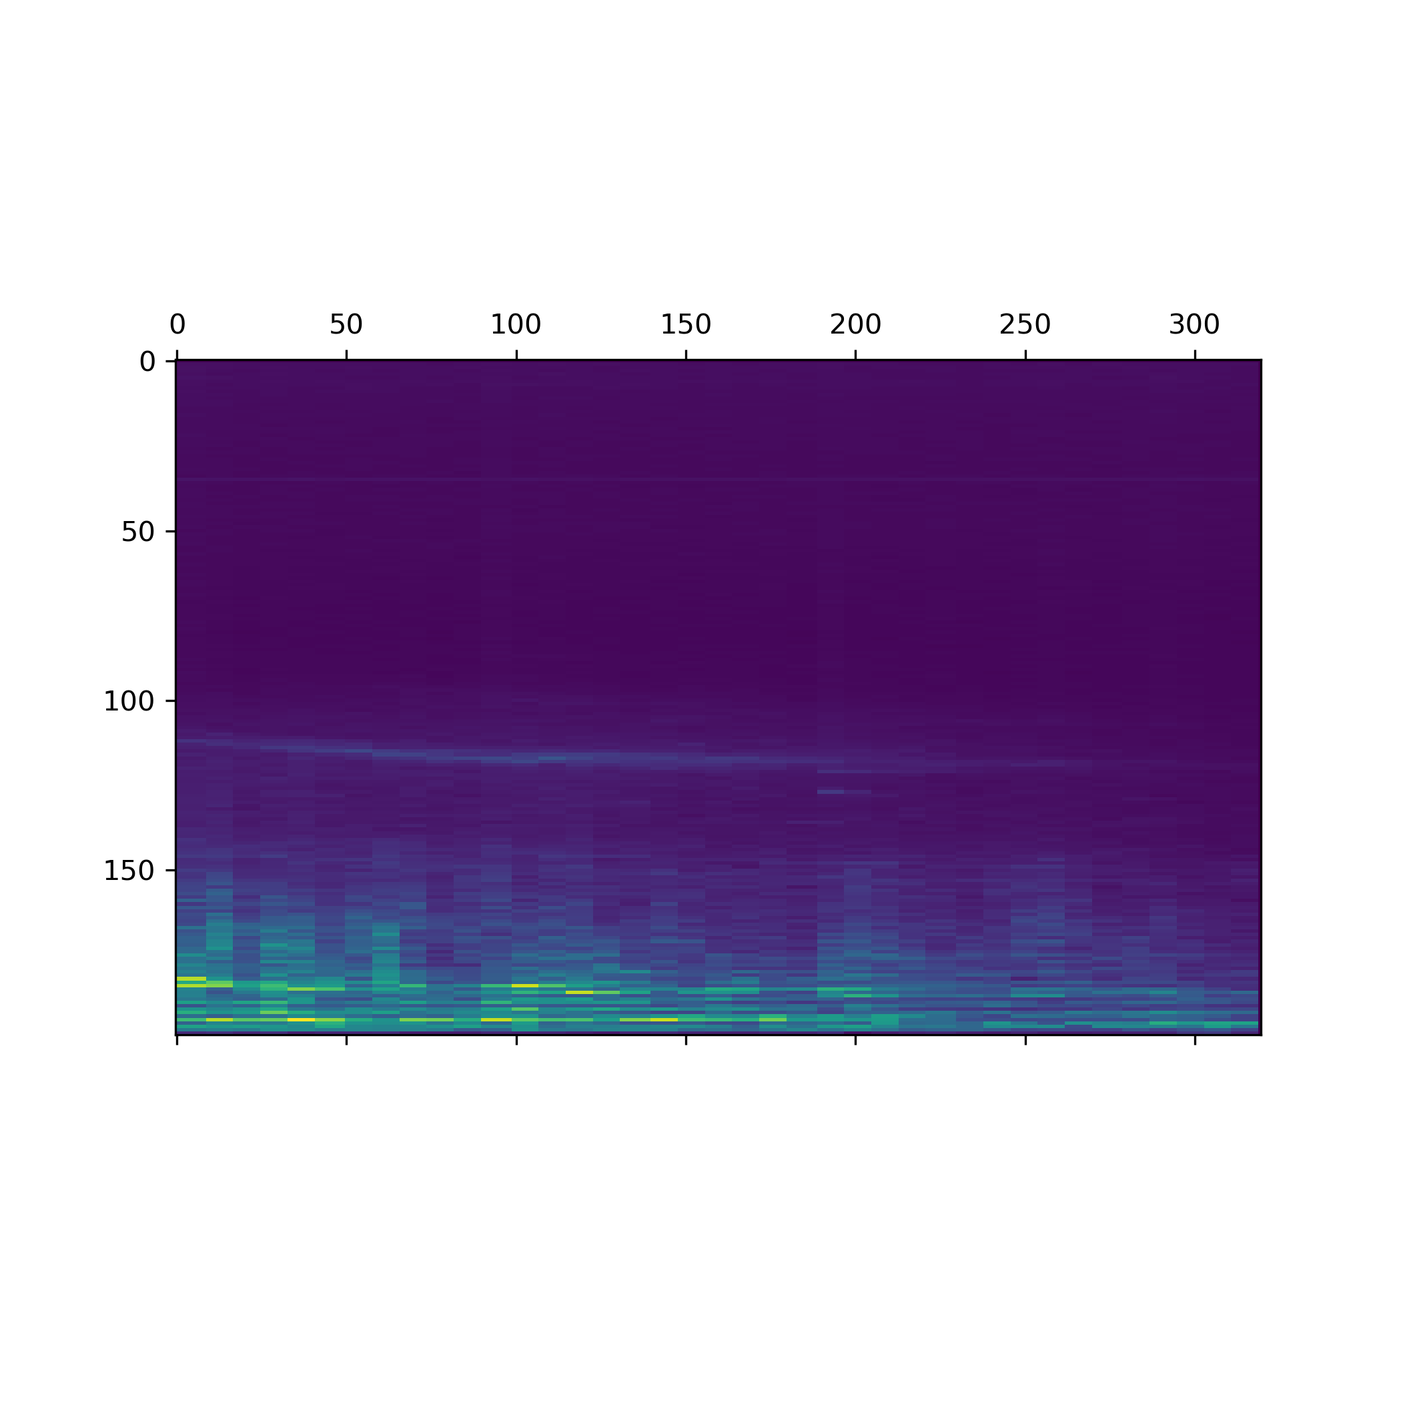
Elements of the Soundscape
Bird Calls
Rain
Airplanes
Frequency (hz)
Time (10s) ->
Time (10s) ->
Time (10s) ->
Click spectrogram to play sound and animation

Slide 4
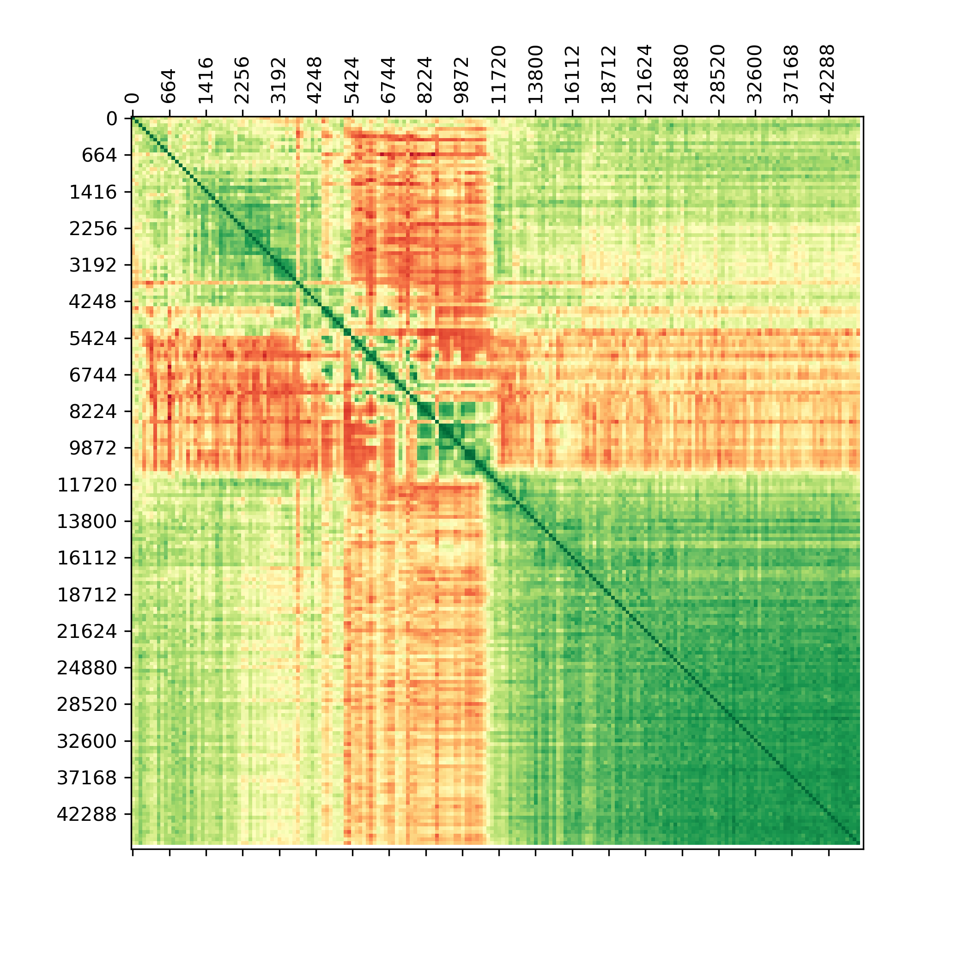
Spectrogram – Bird Songs (SLQA)

Slide 5
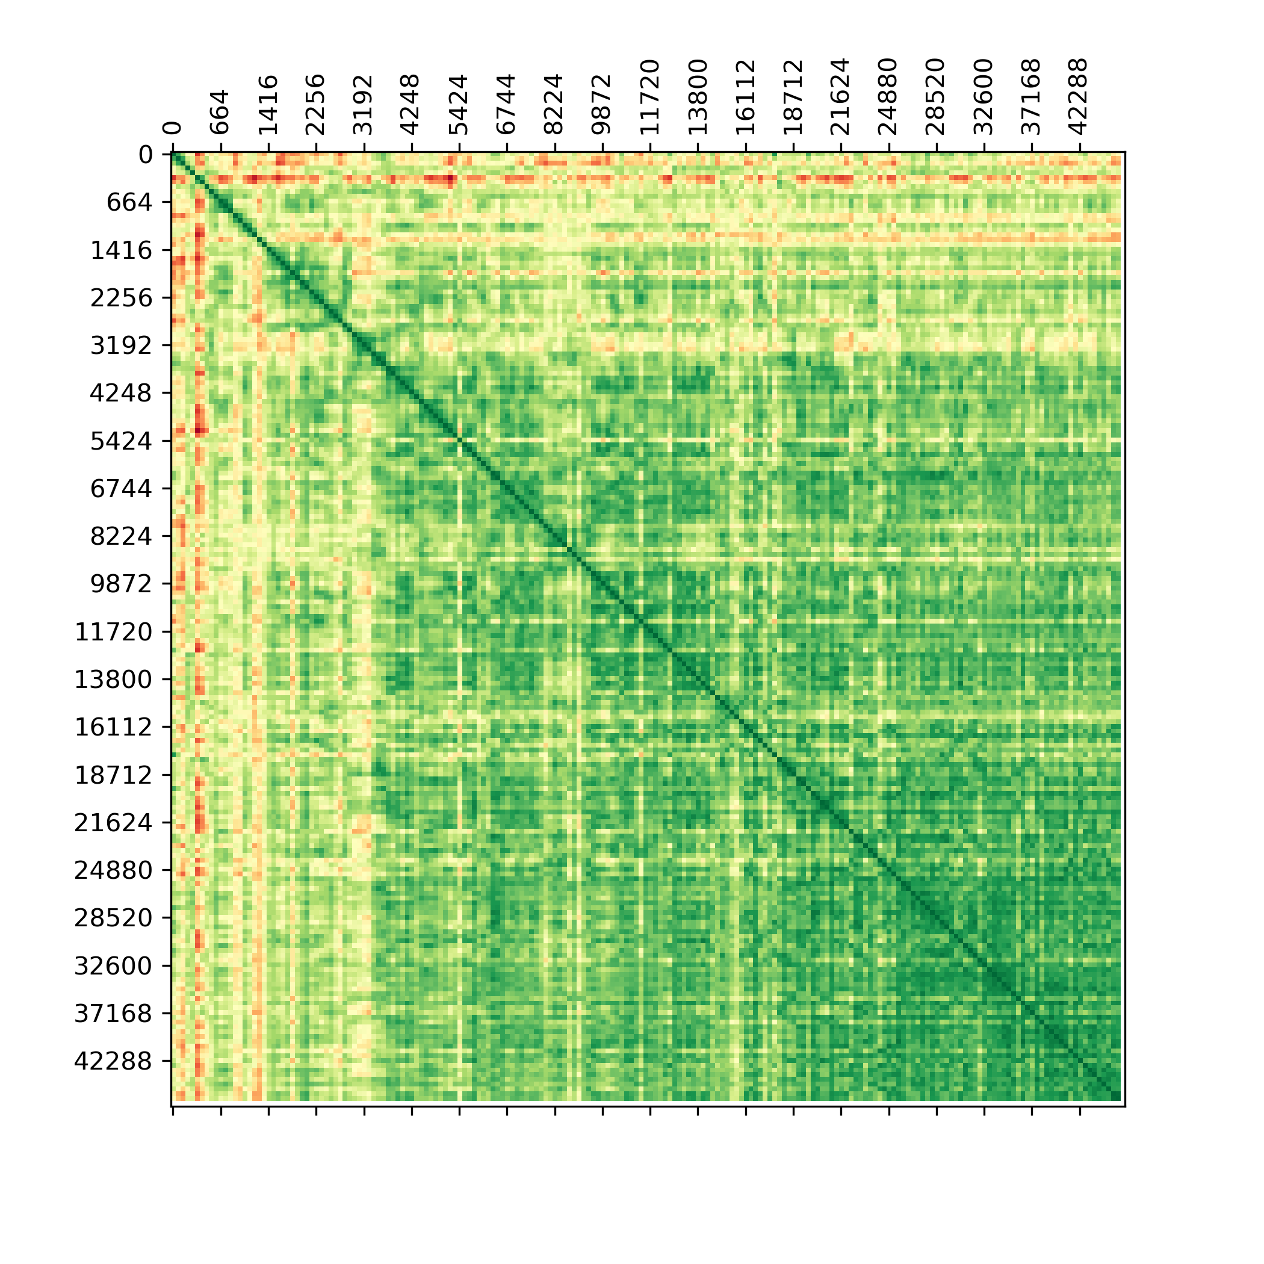
Spectrogram – Heavy Rain (SLQA)
Heavy weather gets its own classification model to be filtered out as outliers

Slide 6
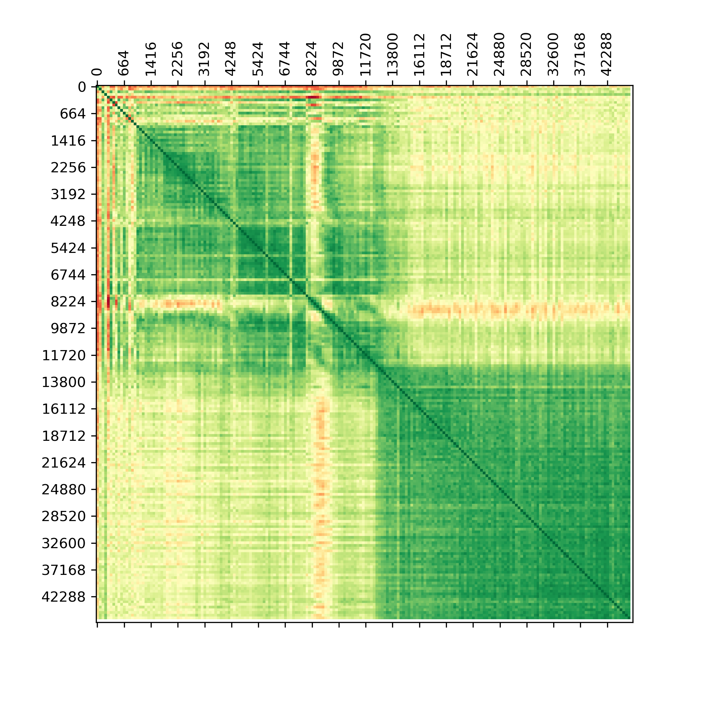
Spectrogram – Planes (SLQA)

Slide 7
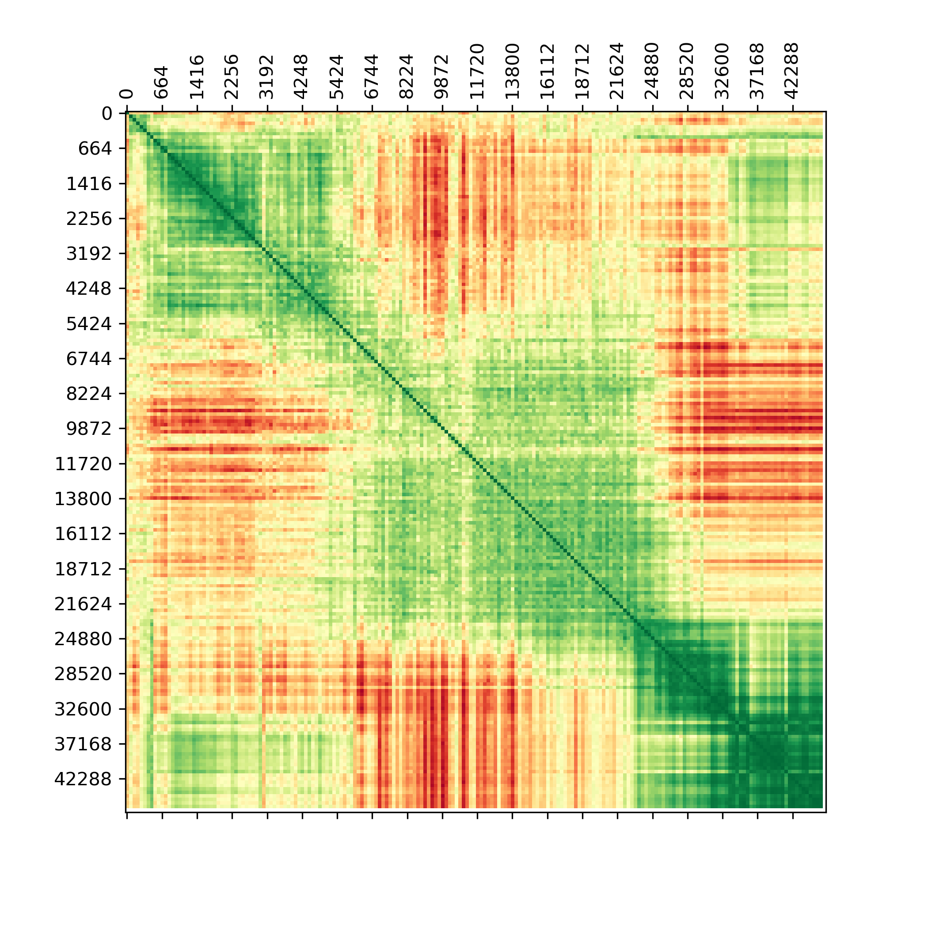
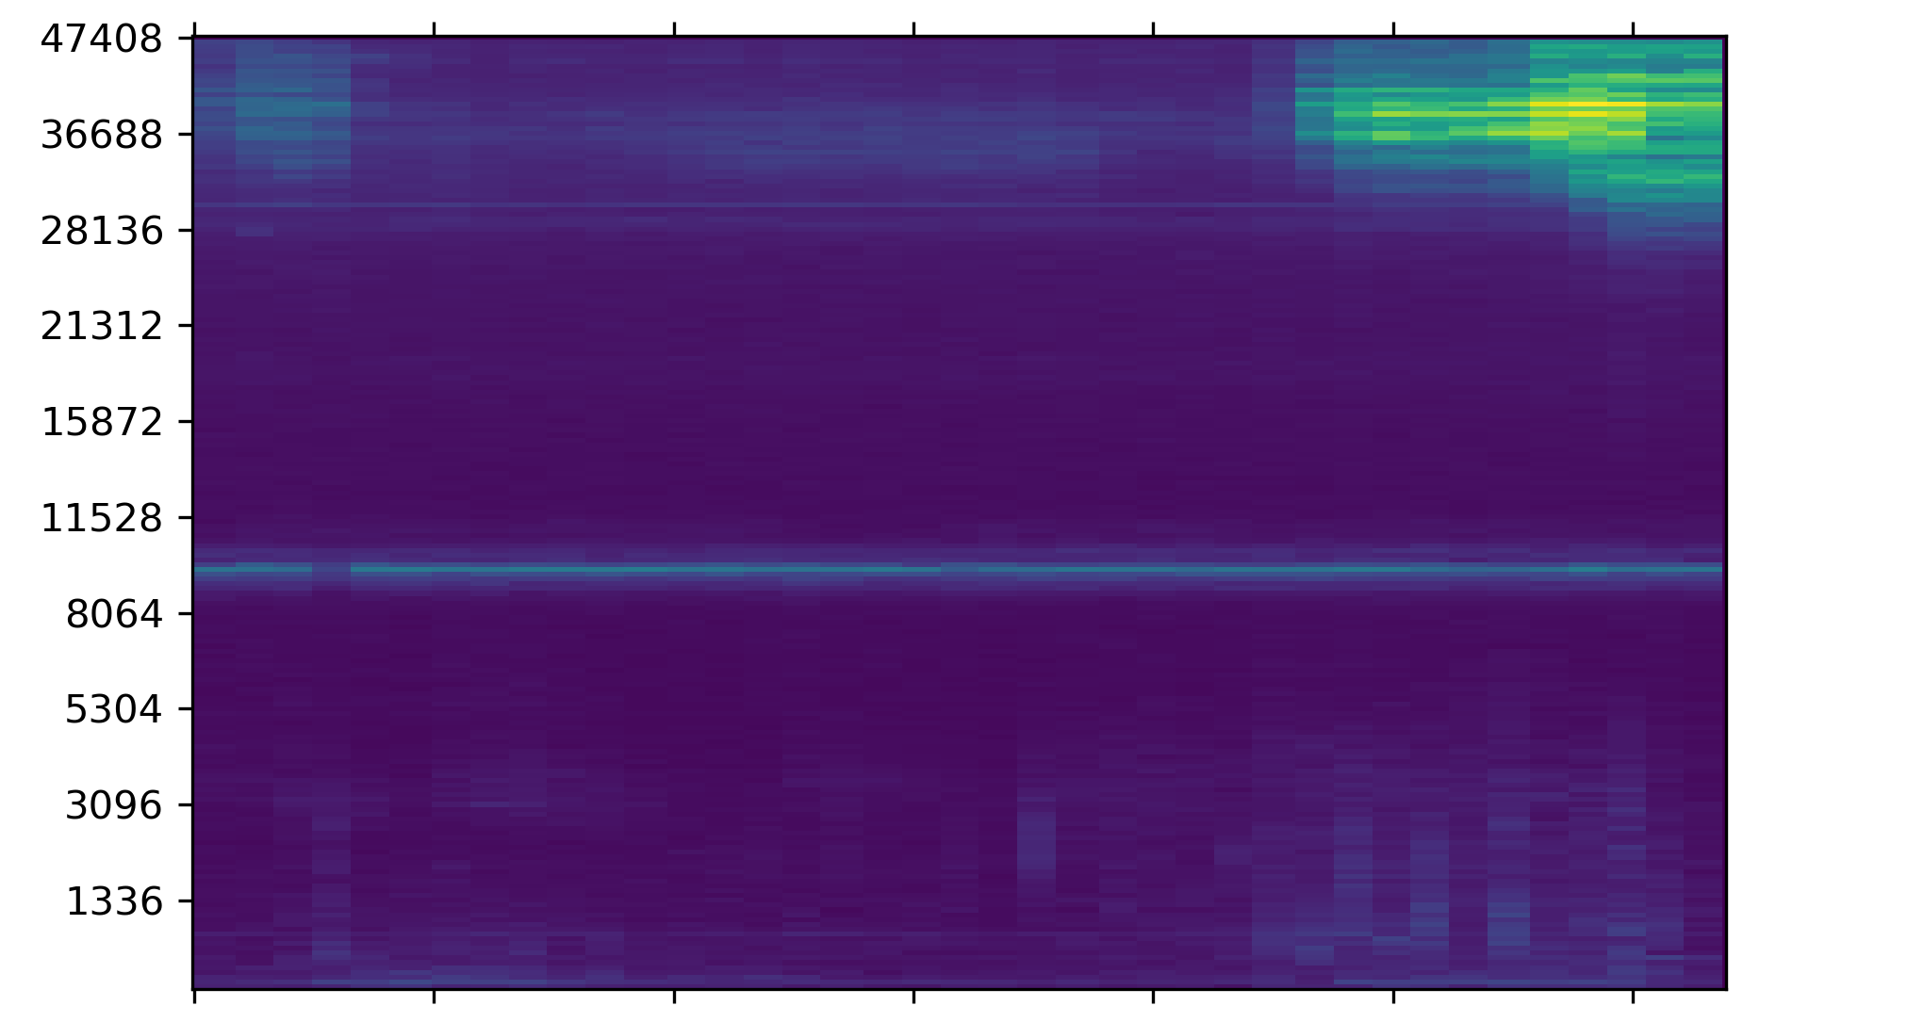
Spectrogram – Entomometer (BBF)

